Slide 1


Predicting Song Popularity using Spotify's Music Dataset
DENISHA SAVIELA

Slide 2
OVERVIEW
SPOTIFY
The Spotify music dataset contains numeric metrics generated by Spotify which measure the songs' danceability, mood, liveness, etc. The goal of this project was to predict the hit songs in future years from multiple artists based on the given dataset.
Notes:
I was interested to use this dataset and explore with the data more to predict Spotify’s songs’ popularity score based on their objective features, especially since song rank has a tremendous financial impact on the creator’s success, since it affects the extent to which their songs would be recommended to other users and generate revenues.

Slide 3
POPULARITY
MODE
VALENCE
DURATION
ENERGY
LIVENESS
TEMPO
Measures how popular a song is by rank
Mode indicates the modality (major or minor) of a track, the type of scale from which its melodic content is derived. Major is represented by 1 and minor is 0.
A measure from 0.0 to 1.0 describes the musical positiveness conveyed by a track. Tracks with high valence sound more positive, while tracks with low valence sound more negative.
The duration of the track in milliseconds.
Energy is a measure from 0.0 to 1.0 and represents a perceptual measure of intensity and activity.
Detects the presence of an audience in the recording. Higher liveness values represent an increased probability that the track was performed live.
The overall estimated tempo of a track in beats per minute (BPM). In musical terminology, tempo is the speed or pace of a given piece and derives directly from the average beat duration.
INSTRAMENTALNESS
LOUDNESS
SPEECHINESS
DANCEABILITY
ACOUSTICNESS
TIME_SIGNATURE
Predicts whether a track contains no vocals. "Ooh" and "aah" sounds are treated as instrumental in this context. Rap or spoken word tracks are clearly "vocal".
The overall loudness of a track in decibels (dB). Loudness values are averaged across the entire track and are useful for comparing relative loudness of tracks.
Speechiness detects the presence of spoken words in a track. The more exclusively speech-like the recording (e.g. talk show, audio book, poetry), the closer to 1.0 the attribute value.
Danceability describes how suitable a track is for dancing based on a combination of musical elements including tempo, rhythm stability, beat strength, and overall regularity. A value of 0.0 is least danceable and 1.0 is most danceable.
A confidence measure from 0.0 to 1.0 of whether the track is acoustic. 1.0 represents high confidence the track is acoustic.
An estimated time signature. The time signature (meter) is a notational convention to specify how many beats are in each bar (or measure). The time signature ranges from 3 to 7 indicating time signatures of "3/4", to "7/4".
Notes:
Here are some of the features that was used to complete this project. The original dataset had more than this including track_id, genre, etc.

Slide 4
REDUCING NUMBER OF SONGS
The database contains more than 232,000 songs. Following the data cleaning process, the number of songs was reduced to 176,000.
PRE-PROCESSING
REMOVING FEATURES
dropping duplicates of track_id
converting time_signature from type object to integer.
Notes:
The dataset was found on Kaggle which contained more that 232,000 songs, and it was eventually reduced to 176,000. The descriptive statistics was helpful in detecting potential anomalies, missing data, and ignoring unnecessary variables. I also converted duration of the songs from seconds to milliseconds.

Slide 5
Model Selection
LINEAR
REGRESSION
RANDOM
FOREST
DECISION
TREE
training score: 0.202
testing score: 0.199
training score: 0.906
testing score: 0.341
training score: 0.998
testing score: -0.350
Notes:
In order to model the data, there were two variables that needed to be declared — X which is a table containing all the songs' features, except popularity, and y which is a vector that contains the songs’ popularity score, and then I separated the database into training and testing sets, and choose to use 80% of the test for training and the rest for testing. These are the 3 algorithms I choose to predict song’s popularity. According to the models’ scores, the decision tree model provides the most accurate predictions. However, the negative testing score for the decision tree model implies that this model’s performance doesn’t follow the trend of the data, leading to a bad fit no matter what song is being tested.

Slide 6
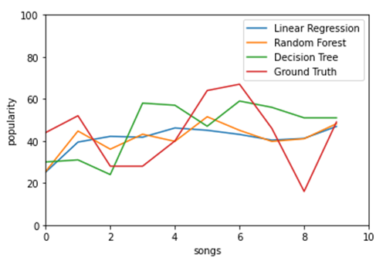
Results and Evaluation
IN THIS PART A VISUALIZATION OF THE MODEL’S PREDICTIONS WAS USED TO COMPARE THEIR ACCURACY USING 10 SONGS TAKEN FROM THE TESTING DATA.
Notes:
I used a graph to compare their accuracy using 10 songs taken from the testing data. The red line represents the songs’ popularity score, while the other three lines represent the models’ prediction. Higher distance from the red line represents a lower accuracy. All three models didn’t perfectly fit the red line, but the random forest provided the closest predictions to the ground truth.

Slide 7
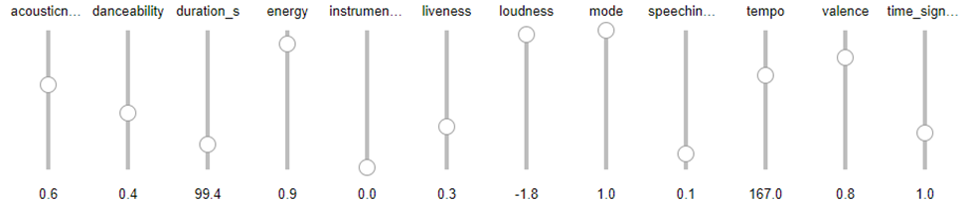
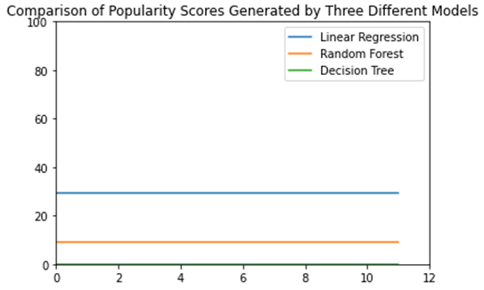
IMPLEMENTING A FEATURE MIXER
A FEATURE MIXER CAN BE USED TO IDENTIFY WHICH FEATURES ARE MOST IMPORTANT IN PREDICTING THE TARGET VARIABLE. THIS CAN BE USEFUL IN FEATURE SELECTION, WHERE CERTAIN FEATURES CAN BE EXCLUDED FROM THE MODEL TO REDUCE COMPLEXITY AND IMPROVE PERFORMANCE.
FOR THE FIRST SET OF FEATURES, ALL THREE MODELS HAVE PREDICTED A DIFFERENT POPULARITY SCORE. BASED ON THE GIVEN INPUT, THE LINEAR REGRESSION GAVE A RANKING OF 35/100 FOR THE FIRST SONG, THE RANDOM FOREST GAVE A RANKING OF 15/100, AND THE DECISION TREE GAVE A RANKING OF 0/100.
Notes:
To understand the model better I used a feature extractor. By doing this, it’s helpful to see which features are most important in predicting the target variable. Most of the features ranged between 0 to 1, while others, like tempo, ranged between 0 to 250 beats per minute (bpm). This was the default setting when the features were first implemented. The graph here is a representation of the current features shown. As you can see all 3 models predicted different scores. Basically you can read this as the linear regression gives a ranking of 35/100 in popularity, random forest gives a ranking of 15/100 and decision tree gives a ranking of 0/100.

Slide 8
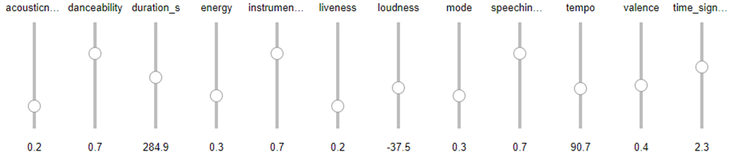
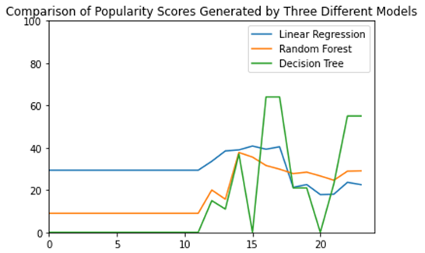
IMPLEMENTING A FEATURE MIXER
THIS VISUALIZATION ALSO SUPPORT MULTIPLE TESTING AND COMPARISON. AS SEEN, INCREASING ACOUSTICNESS, ENERGY LIVENESS, LOUDNESS, TEMPO, AND VALENCE AND RERUNNING THE SCRIPT AGAIN RESULTS IN A DIFFERENT GRAPH AND RESULTED IN AN INCREASED POPULARITY RANKING.
THE GRAPH ENABLES IT TO EASILY COMPARE THE THREE MODELS’ PREDICTIONS BEFORE AND AFTER THE CHANGES MADE. BOTH THE DECISION TREE AND THE RANDOM FOREST MODELS PREDICTED THE FIRST CHANGES HAD INCREASED IN POPULARITY, WHILE THE LINEAR REGRESSION PREDICTION WAS LOWER.
Notes:
Changing the feature extractor will give a different graph. You can also see the graph keeps the information from the previous feature setting and shows the feature setting now.

Slide 9
Predicting Song Popularity using Spotify's Music Dataset
Denisha Saviela
OVERVIEW
FEATURE MIXTURE
The Spotify music dataset contains numeric metrics generated by Spotify which measure the songs' danceability, mood, liveness, etc. The goal of this project was to predict the hit songs in future years from multiple artists based on the given dataset.
A feature mixer can be used to identify which features are most important in predicting the target variable. The features can be manipulated which will change the predication popularity score. The graph on the left is a representation of the current features below it. Based on the given input, the linear regression gave a ranking of 35/100 for the first song, the random forest gave a ranking of 15/100, and the decision tree gave a ranking of 0/100. Changing the feature extractor will give a different graph and result of the song. The graph on the right shows the new popularity score based on the changed features below it.
PRE-PROCESSING
REDUCING NUMBER OF SONGS
The database contains more than 232,000 songs. Following the data cleaning process, the number of songs was reduced to 176,000.
RESULTS AND EVALUATION
MODEL SELECTION
LINEAR REGRESSION
training score: 0.202
testing score: 0.199
The red line represents the songs’ popularity score, while the other three lines represent the models’ prediction. Higher distance from the red line represents a lower accuracy. All three models didn’t perfectly fit the red line, but the random forest provided the closest predictions to the ground truth.
REMOVING FEATURES
RANDOM FOREST
training score: 0.906
testing score: 0.341
Dropping duplicates of track_id and converted time_signature from type object to integer.
DECISION TREE
training score: 0.998
testing score: -0.350

